Slide 1
Data Space Accelerator
A publicly funded study to lower the entry barriers into Catena-X
V 1.0

Slide 2





Catena-X provides a shared language & unified framework for data exchange.
What does Catena-X do?
Before Catena-X
After Catena-X
Customer A
Customer B
Customer Z
Customer A
Customer B
Customer Z
Use
Case 1
Use
Case 2
Use
Case 3
Use
Case …
Use
Case 1
Use
Case 2
Use
Case 3
Use
Case …
Use
Case 1
Use
Case 2
Use
Case 3
Use
Case …
Use
Case 1
Use
Case 2
Use
Case 3
Use
Case …
Use
Case 1
Use
Case 2
Use
Case 3
Use
Case …
Use
Case 1
Use
Case 2
Use
Case 3
Use
Case …
With Catena-X, companies can exchange any kind of data based on common standards and clearly defined usage policies. The principle of data sovereignty lies at its foundation: the data owner decides what is shared, with whom, and under what conditions.
3rd party data intermediary
3rd party data intermediary
Company X
Company X
Use Case 1
Use Case 2
Use
Case 1
Use
Case 2
Use
Case 3
Use
Case …
Use Case 3
Use Case …
Lower costs, less manual effort
Ease of value chain collaboration
Security & decentralization
Be an attractive partner
Supplier
Supplier
Supplier
Supplier
Supplier
Supplier

Slide 3



Why Catena-X matters beyond the Data Space Accelerator.
The bigger picture
Resiliency & cost savings
Move data up and down the value chain across every tier, strengthening core processes like quality and logistics.
Regulatory readiness at scale
Meet requirements such as product passports and CSDDD once, then reuse that readiness across customers and regulations.
A seat in the next industry standard
Interoperability, trust and global acceptance are becoming baseline expectations — early participants help shape how it works.
+400
Global companies onboarded only in H1 2026
Already the mandatory procurement standard for a European OEM
Data spaces are becoming essential infrastructure for every industry, the same way electricity and the internet once did. Participating pays off far beyond this one program.

Slide 4



2026 is the year to join Catena-X. Get up to €30,000 back for your first data exchange
Joining Catena-X just got better; Get up to €30,000 remuneration.

Slide 5


The Data Space Accelerator Study
The Data Space Accelerator is a study funded by the German Ministry for Economic Affairs and Energy (BMWE) and coordinated by the International Data Spaces Association (IDSA).
What the study delivers:
Empirical evidence on economic and organizational benefits of data sharing.
Actionable recommendations to strengthen digital readiness.
Case‑based insights from multiple use cases.

Slide 6






Benefits beyond the remuneration.
What participation means in practice
Before the study
With the Data Space Accelerator Study
Joining a Data Space takes effort
Data spaces offer significant benefits.
Yet, understanding requirements, roles and processes requires learning and orientation.
Easily join Catena‑X
Start with a simple, predefined use case that enables meaningful participation in a data space.
Participation requires upfront investment
Time, internal resources, and initial setup effort are needed before companies become operational in a data space.
Guided Onboarding
No prior data space experience is required. Onboarding and use‑case implementation can optionally be supported by certified partners.
Benefits scale at ecosystem level
Efficiency gains and economic benefits increase as more companies participate, making contributions essential to reaching
a critical mass.
Remuneration
Receive remuneration based on verified results. Remuneration is paid after successful onboarding and proven productive data sharing.

Slide 7

Choose your path into Catena-X
Basic Path (Lot 1)
Data space onboarding
Use case: Company Certificate Management
Baseline questionnaire
Follow-up questionnaire
Remuneration of
EUR 15,000
(net plus VAT)
Advanced Path (Lot 2)
Data space onboarding
Use case: Company Certificate Management
Baseline questionnaire
Follow-up questionnaire
Additional Catena-X
use case
Explore more use cases at www.cofinity-x.com
Remuneration of
EUR 30,000
(net plus VAT)
Recommended
Notice: For participants based outside Germany, the remuneration amount is recalculated using a purchasing power index. Details can be found in the program tender documents.

Slide 8
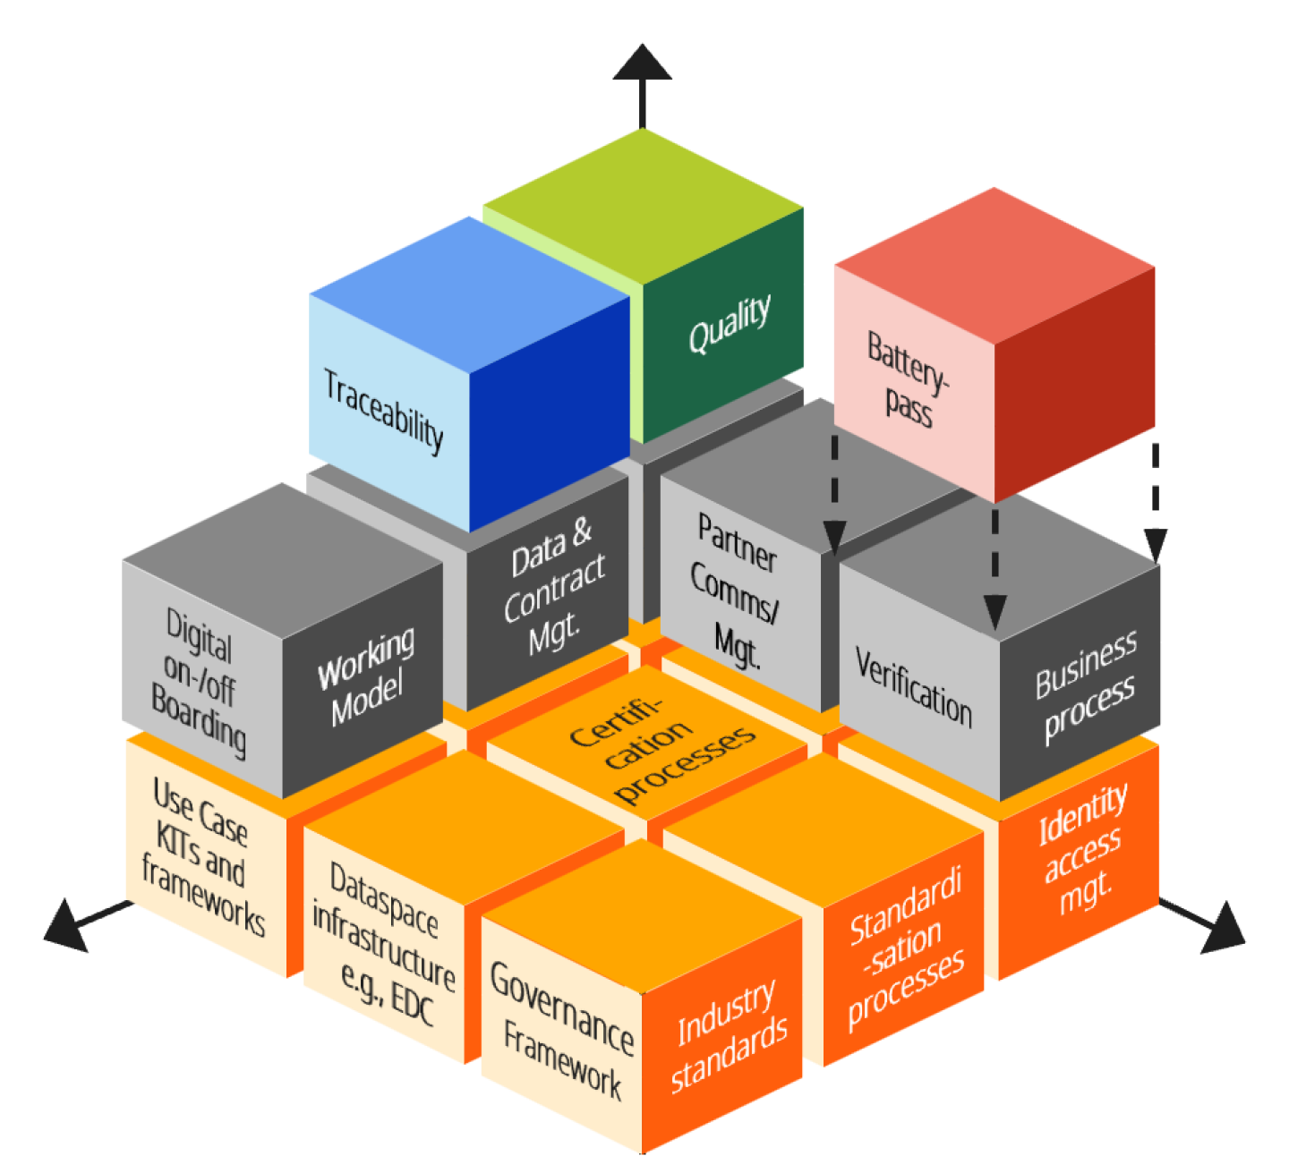




Leverage use cases with ease once you start on your path.
Exact usecases to add
Certificate Management
Product Carbon Footprint
Demand & Capacity Management
Traceability

Slide 9








Leverage use cases with ease once you start on your path.
 | Basic Path | Advanced Path
Company Certificate Management | ✓ | ✓
Product Carbon Footprint | ✕ | ◉
Digital Product Passport | ✕ | ◉
Demand & Capacity Management | ✕ | ◉
Traceability | ✕ | ◉
Quality | ✕ | ◉
Short Term Supply Management (PURIS) | ✕ | ◉
Business Partner Data Management | ✕ | ◉
Legend: ✓ Included in the path | ✕ Not included in the path | ◉ Companies can choose one additional use case from the list

Slide 10



Program Eligibility & Requirements
Requirements
Retroactive Entry
Eligible Countries
At least 10 employees and €500,000 revenue in each of the last three calendar years.
Companies that joined the data space since
1 May 2026 can participate retroactively.
All EU member states and the following countries:
Armenia
Aruba (via the Netherlands)
Australia
Canada
Chinese
Taipei / Taiwan
Hong Kong (China)
Iceland
Israel
Japan
Liechtenstein
Moldova
Montenegro
New Zealand
North
Macedonia
Norway
Singapore
South Korea
Switzerland
Ukraine
United
Kingdom
United States
Two Surveys, One Storyline
Setup survey (baseline)
Captures the starting point: business innovation, data strategy & governance, data usage & quality, data products, internal/external/data space exchange, IT landscape, and Catena-X readiness.
1
Exit survey (follow-up)
After the first productive data exchange: measures change in readiness, usage intensity, organizational adaptation, and the value experienced by the company.
2
The participation is measured before and after onboarding. Comparing the two waves lets the study show genuine organizational change — not just differences between respondents.

Slide 11
Join the study in 6 easy steps
1
Submit Offer & Choose Path
2
Review & Acceptance
3
Select your Use Cases
By fully completing and submitting this offer form, the company submits a binding offer including his chosen path to perform the public tender under the Data Space Accelerator Program.
The program coordinator will review your application against the terms and conditions. Once approved, you'll receive confirmation and can proceed.
Based on your chosen program path, you proceed either with Company Certificate Management only or decide for an additional Catena-X use case. You then complete the baseline questionnaire.
4
Data Space Onboarding
5
First Data Sharing
6
Receive Remuneration
You are guided through the Cofinity-X onboarding process to connect your company to the Catena-X productive environment.
You complete and demonstrate a data exchange in the data space along your use case with Cofinity-X. No customer or live data is required. After that, you receive your Data Readiness Certificate.
Submit your Data Readiness Certificate to the program coordinator and claim your remuneration once everything is verified.

Slide 12
For us as a medium-sized company, the biggest challenge was not the technology itself, but taking the first steps into Catena-X. The Data Space Accelerator study significantly lowered the barriers to entry. We were able to implement our first concrete use case and gain valuable hands-on experience within a short period of time.
“
Tobias Ott
Technical Managing Director, KSE GmbH

Slide 13








Endorsed by industry giants!

Slide 14



Program Partners
Strong partners for your data space success
International Data
Spaces e. V.
Program organizer driving the vision of sovereign data sharing across industries and enabling trusted data ecosystems worldwide.
Catena-X Automotive Network e. V.
Governance body of the Catena-X data space, establishing standards and rules for secure, interoperable data exchange in the automotive industry.
Cofinity-X GmbH
Secure and trusted data space operating company, providing the technical infrastructure to connect and exchange data within the Catena-X ecosystem.

Slide 15



Your first data exchange starts here
Find answers to the most important
questions about the program in
the FAQ section .
https://data-space-accelerator.com/

Slide 16
Choose your path into Catena-X
Option 1
Basic Path (Lot 1)
Advanced Path (Lot 2)
Recommended
Data space onboarding
Use case: Company Certificate Management
Baseline questionnaire
Follow-up questionnaire
Data space onboarding
Use case: Company Certificate Management
Baseline questionnaire
Follow-up questionnaire
Additional Catena-X
use case
Explore more use cases at www.cofinity-x.com
Remuneration of
EUR 15,000
(net plus VAT)
Remuneration of
EUR 30,000
(net plus VAT)
Notice: For participants based outside Germany, the remuneration amount is recalculated using a purchasing power index. Details can be found in the program tender documents.

Slide 17

Choose your path into Catena-X
Option 2
Basic Path (Lot 1)
Advanced Path (Lot 2)
Recommended
Data space onboarding
Use case: Company Certificate Management
Baseline questionnaire
Follow-up questionnaire
Data space onboarding
Use case: Company Certificate Management
Baseline questionnaire
Follow-up questionnaire
Additional Catena-X
use case
Explore more use cases at www.cofinity-x.com
Remuneration of
EUR 15,000
(net plus VAT)
Remuneration of
EUR 30,000
(net plus VAT)
Notice: For participants based outside Germany, the remuneration amount is recalculated using a purchasing power index. Details can be found in the program tender documents.

Slide 18
Two surveys, one storyline
After the 20M slide
The measurement
The participation is measured before and after onboarding. Comparing the two waves lets the study show genuine organizational change — not just differences between respondents.
1
2
Setup survey (baseline)
Exit survey (follow-up)
Captures the starting point:
business innovation, data strategy & governance, data usage & quality, data products, internal/external/data space exchange, IT landscape, and Catena-X readiness.
After the first productive data exchange: measures change in readiness, usage intensity, organizational adaptation, and the value experienced by the company.
DSA
www.data-space-accelerator.com/en/study

Slide 19
Who the Program is for
Change information to as one pager
Suppliers not yet active in Catena-X
Primarily small and mid-sized – Tier 1, 2, 3, n | larger companies also welcome
Automotive and adjacent industries (e.g. mechanical engineering)
Joining in 2026
Catena-X onboarding planned for this year
Use case commitment
at least 1 concrete use case deployable in daily operations
Study participation
Accompanying survey on effort and value created
DSA
www.data-space-accelerator.com

Slide 20
What’s in it for me?
Consolidate with how it works
What participation means in practice
Easily join Catena‑X: Start with a simple, predefined use case that enables meaningful participation in a data space.
Guided Onboarding: No prior data space experience is required. Onboarding and use‑case implementation can optionally be supported by certified partners.
Remuneration: Receive remuneration based on verified results. Remuneration is paid after successful onboarding and proven productive data sharing.
DSA
www.data-space-accelerator.com

Slide 21



Why getting started takes effort
Move to after the 20M slide
Three structural realities of joining a data space
Joining a Data Space takes some effort
Data spaces offer significant benefits.
Yet, understanding requirements, roles and processes requires learning and orientation.
Participation requires upfront investment
Time, internal resources, and initial setup effort are needed before companies become operational in a data space.
Benefits scale at ecosystem level
Efficiency gains and economic benefits increase as more companies participate, making contributions essential to reaching
a critical mass.
DSA
www.data-space-accelerator.com

Slide 22


Choose Your Path
Choice based on your available capacity and ambition
A
Move to 20M slide
Recommended
B
Move graphic to new slide
Basic Path (Lot 1)
Advanced Path (Lot 2)
Remuneration of
EUR 15,000
(net plus VAT)
Remuneration of
EUR 30,000
(net plus VAT)
Data space onboarding
Use case: Company Certificate Management
Baseline questionnaire
Follow-up questionnaire
Data space onboarding
Use case: Company Certificate Management
Baseline questionnaire
Follow-up questionnaire
Additional Catena-X
use case
Explore more use cases
at www.cofinity-x.com
Notice: For participants based outside Germany, the remuneration amount is recalculated using a purchasing power index. Details can be found in the program tender documents.
DSA
www.data-space-accelerator.com

Slide 23
How It Works
From Offer to Compensation in 6 Easy Steps
1
2
3
Submit Offer & Choose Path
By fully completing and submitting this offer form, the company submits a binding offer to perform the public tender under the Data Space Accelerator Program.
Review and Acceptance
The program coordinator will review your application against the terms and conditions. Once approved, you'll receive confirmation and can proceed.
Select Your Use Cases
Based on your chosen program path, you proceed either with Company Certificate Management only or decide for an additional Catena-X use case. You then complete the baseline questionnaire.
4
5
6
Data Space Onboarding
You are guided through the Cofinity-X onboarding process to connect your company to the Catena-X productive environment.
First Data Sharing
You complete and demonstrate a real data exchange in the data space along your use case. After that, you receive your Data Readiness Certificate.
Receive Remuneration
Submit your Data Readiness Certificate to the program coordinator and claim your remuneration once everything is verified.
DSA
www.data-space-accelerator.com

Slide 24
Program Partners
Add new slide for the quotes
Strong partners for your data space success
New slides for endorsed by logos
International Data Spaces e. V.
Program organizer driving the vision of sovereign data sharing across industries and enabling trusted data ecosystems worldwide.
Catena-X Automotive Network e. V.
Governance body of the Catena-X data space, establishing standards and rules for secure, interoperable data exchange in the automotive industry.
Cofinity-X
GmbH
Secure and trusted data space operating company, providing the technical infrastructure to connect and exchange data within the Catena-X ecosystem.
DSA
www.data-space-accelerator.com

Slide 25


Your first data exchange starts here.
Find in the FAQ section answers to the most important questions about the program.
DSA
www.data-space-accelerator.com
V 1.0

Slide 26

What the study delivers
Appendix slide – redesign but last
Purpose & output
Adoption Gap Diagnosis
Readiness gaps and their root causes, mapped along the full data value chain — symptoms separated from causes.
High-Probability Adoption Profiles
Which company types, use cases and context conditions lead to faster productive participation.
Targeted Interventions
Evidence-based levers replacing generic onboarding — actionable for Catena-X and other data spaces.
DSA
www.data-space-accelerator.com/en/study

Slide 27
Data Space Accelerator Study
Consolidate with choose your path and show 30k more
Purpose and Outputs
The Data Space Accelerator is a study funded by the German Ministry for Economic Affairs and Energy (BMWE) and coordinated by the International Data Spaces Association (IDSA).
What the study delivers:
Empirical evidence on economic and organizational benefits of data sharing.
Actionable recommendations to strengthen digital readiness.
Case‑based insights from multiple use cases.
Public Funds
>€ 20 M.
15k or 30k €
Study Period 2026
IDSA
Catena-X
Cofinity-X
Notice: For participants based outside Germany, the remuneration amount is recalculated using a purchasing power index. Details can be found in the program tender documents.
DSA
www.data-space-accelerator.com

