Slide 1


Let’s Build Data Spaces
based on IDS

Slide 2
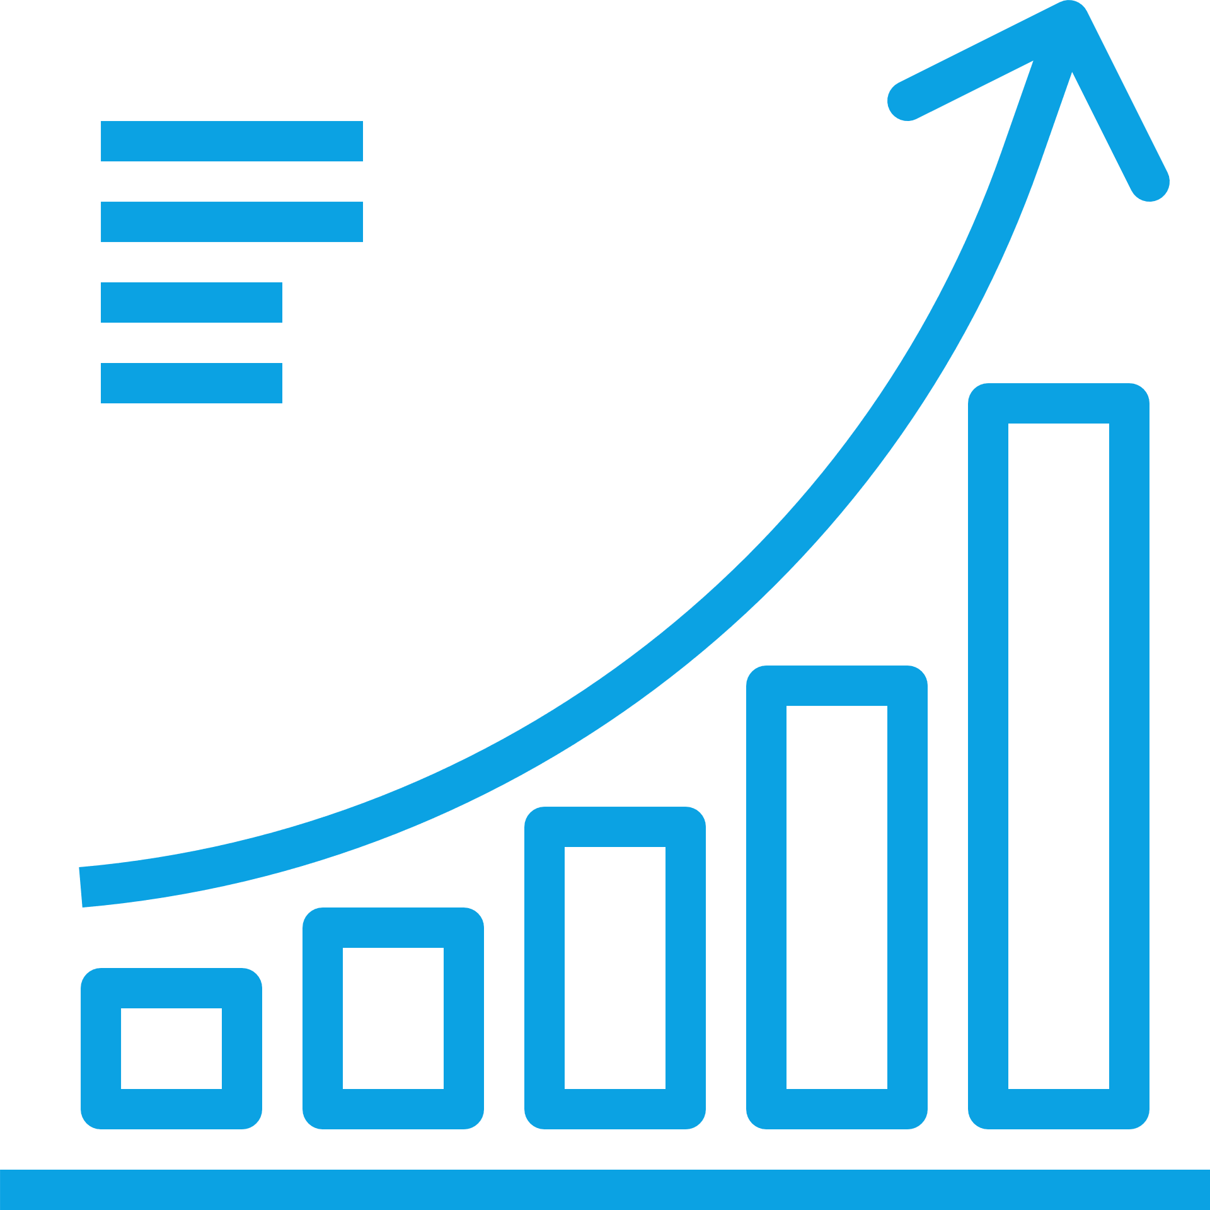

Data Volume is Expected to Explode
Data is crucial for value creation
530% increase of global data volume*
from 33 zettabytes in 2018 to 175 zettabytes in 2025
€829 billion*
value of data economy in the EU27
From €301 billion (2.4% of EU-GDP) in 2018
Companies could use this data to add value, but they don’t
*projected figures 2025 (European Commission)
Notes:
Companies could use this data to add value … but they don’t. Why is this?

Slide 3

We are Lacking a Data Sharing Framework
Availability of data remains limited
For companies to add value, there is a need for data ecosystems that:
are vendor-independent
connect platforms
are open to all at low cost
are easy to adopt and easy to use
Notes:
While an increasing amount of data is being generated, the cross-company and cross-border availability of such data remains too limited due to the lack of a data sharing framework Europe and beyond.

Slide 4
The Data Economy Involves Many Players
Evolution of data sharing
Bilateral data exchange 1:1
Closed community data sharing few-to-few
Open dynamic data ecosystem:
many-to-many
Market Adoption
Notes:
Data-based business models need innovative collaborations across company and competitive boundaries
Data must be shared in open data ecosystems
Data-based business models have two special features:
1) With the provision, storage and processing of data in the value creation process, the boundary between physical products and the virtual world becomes blurred
2) The value creation process often involves multiple stakeholders
Consequence: different data must be brought together in a common ecosystem so that data-based business models become possible. Such an ecosystem must be open, interoperable and it also must preserve data sovereignty.

Slide 5
Companies Want to Link Data
Data ecosystems must preserve data sovereignty
Interoperability
Data Exchange
“Sharing Economy”
Data Centric Services
Data Sovereignty
is the ability of a natural or
legal person to exclusively
and sovereignly decide concerning the usage of data
as an economic asset.
Data Ownership
Data Security
Data Value
Notes:
Data ecosystems must preserve data sovereignty. This means the data owner is able to attach terms of use to their data before passing it on to a consumer. In order to use the data, the consumer must accept the usage policies.
This type of data sharing takes place in a data space.

Slide 6
This is a Data Space
A concept for connecting all kinds of data endpoints
A data space is the sum of all end points that are able to share data with each other.
Federated data architecture: no physical data integration, leave data where it is
Interoperability: no silos, no vendor-dependency
Data Sovereignty and traceability
Trusted participants

Slide 7

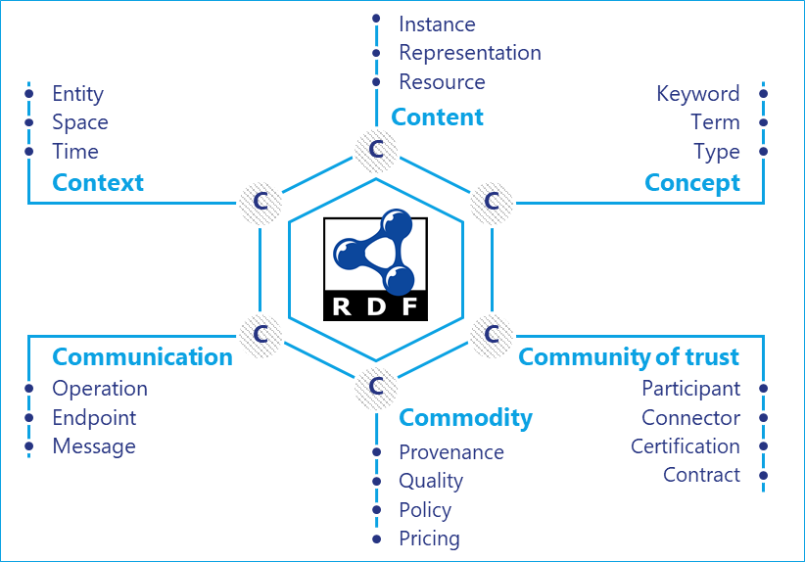
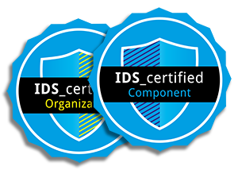
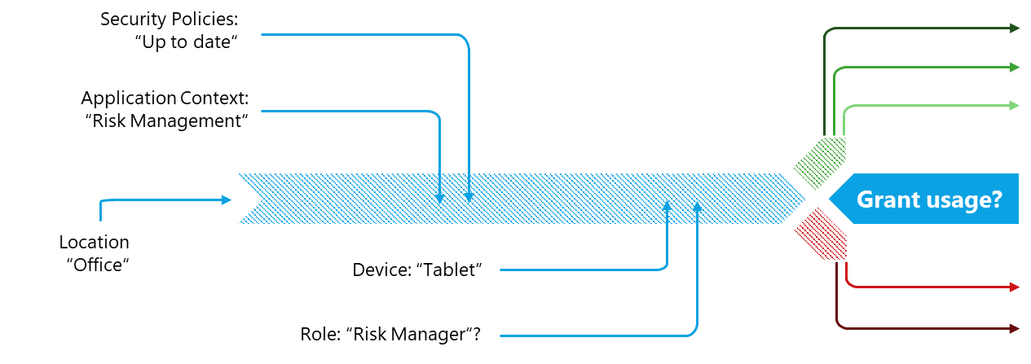
International Data Spaces Approach
IDS-based data spaces are built on three pillars
Unlimited
Interoperability
Trust between different security domains
Governance for
the data economy
Standard for data flows between all kinds of data enbdpoints
Certified, comprehensive security functions providing a maximum level of trust
Usage control and enforcement
for data flows
Information Model
Certification Scheme
Concept of usage control

Slide 8
































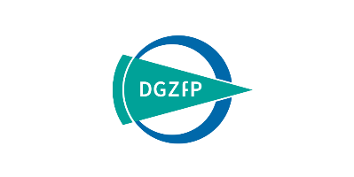

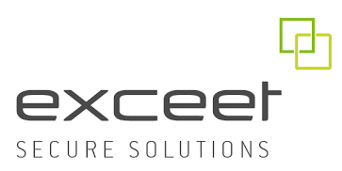


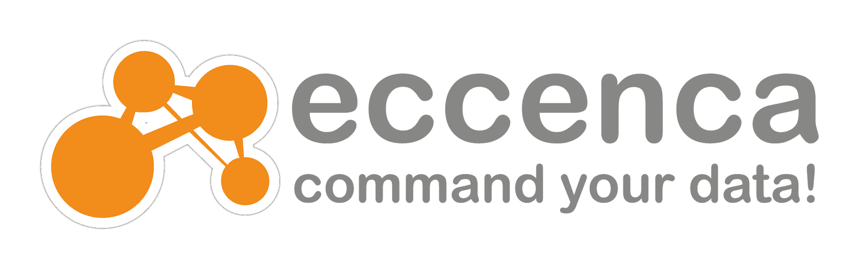

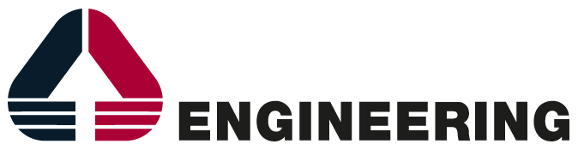




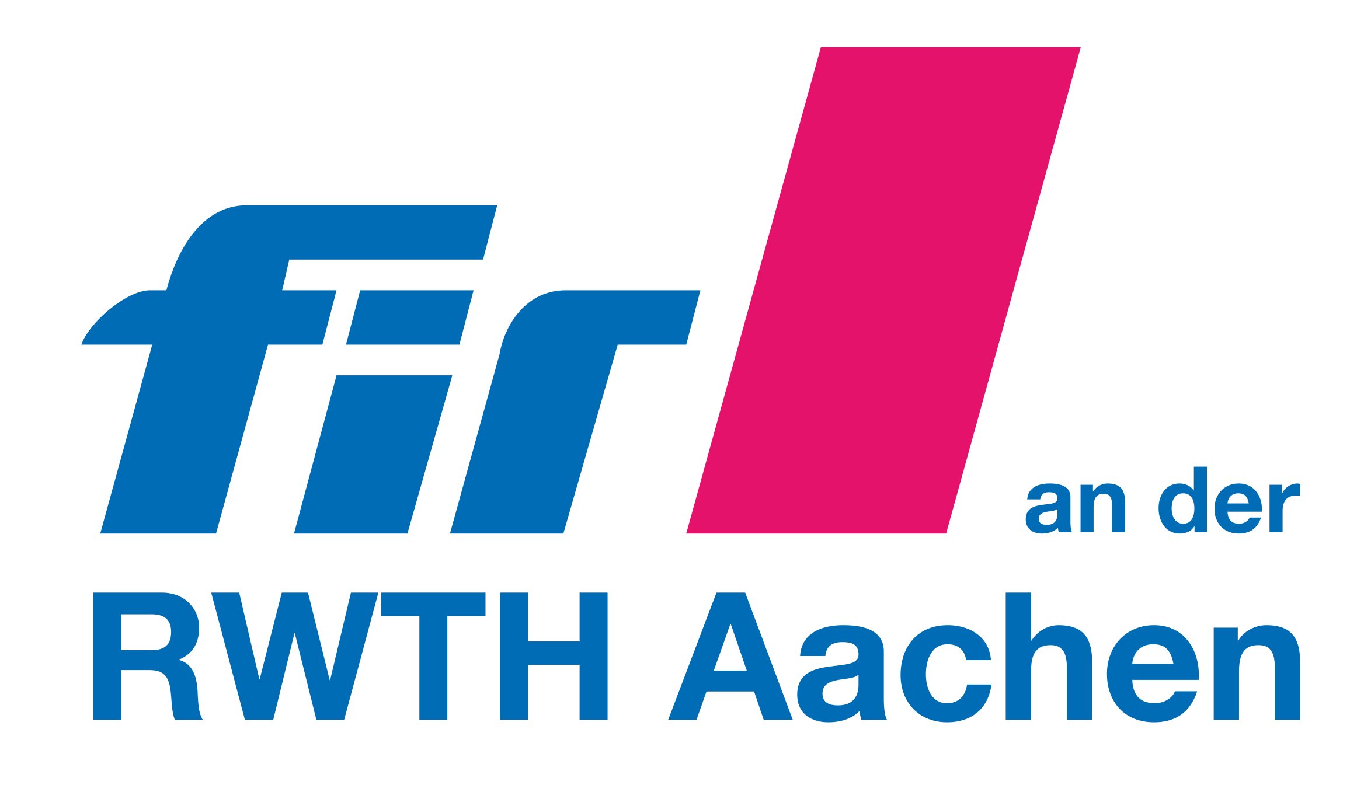
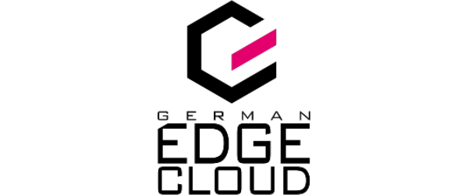









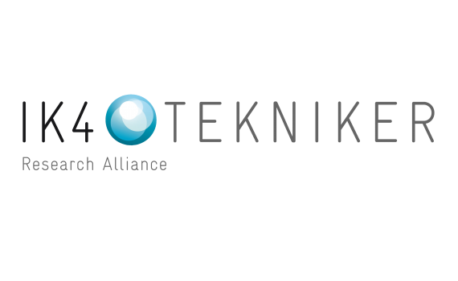
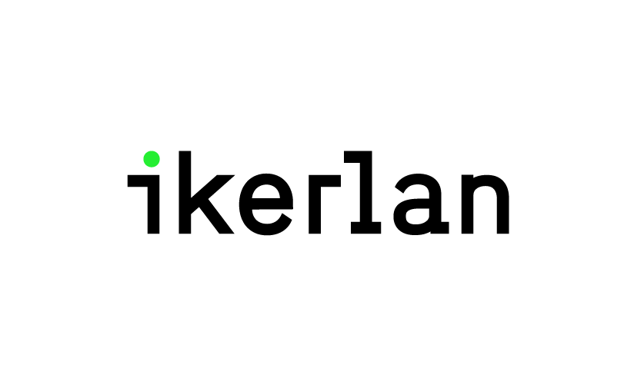



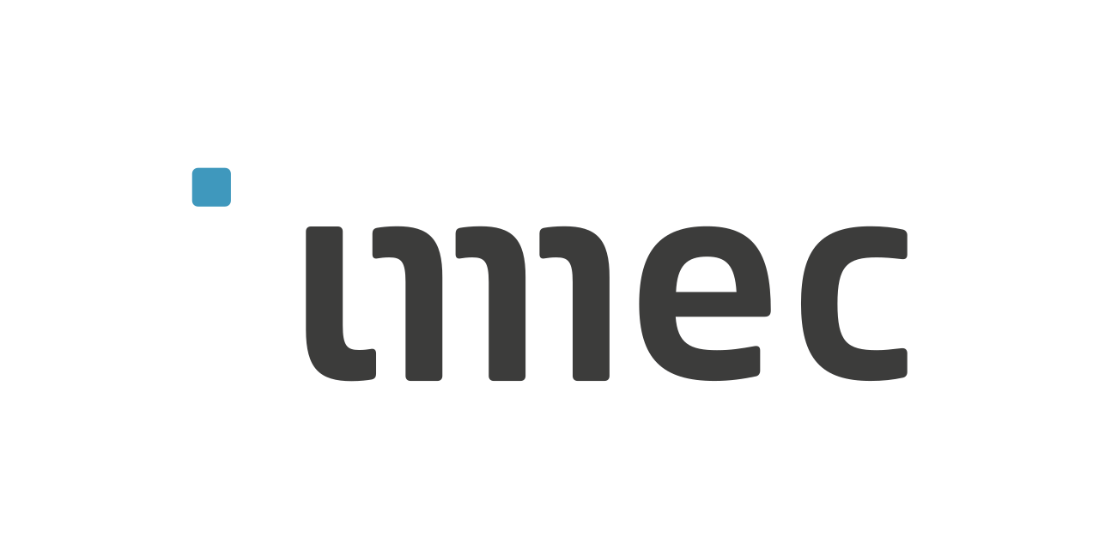





















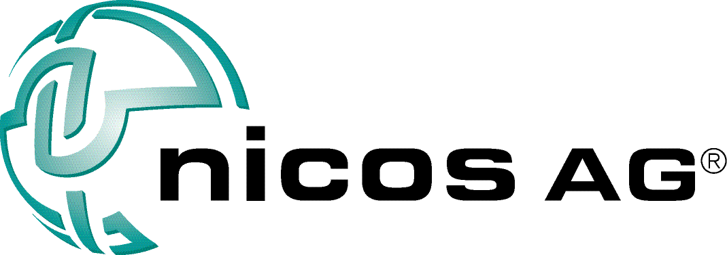






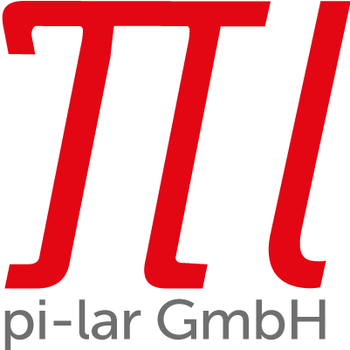




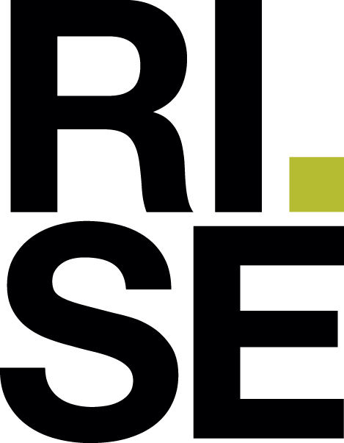



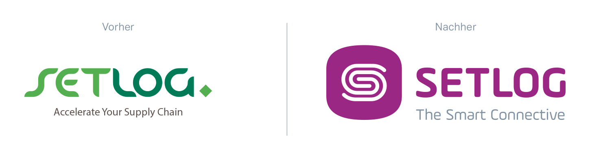






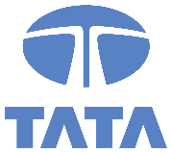






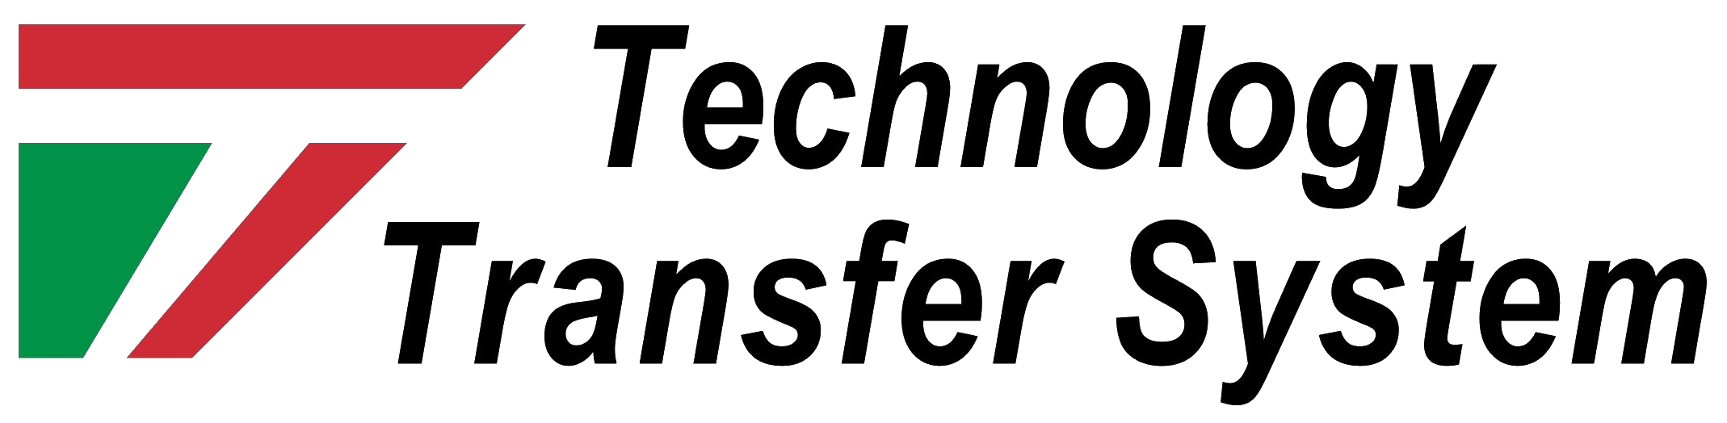





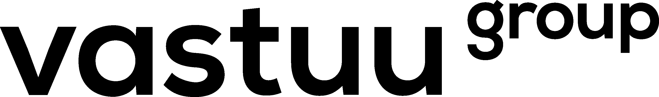
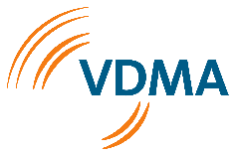

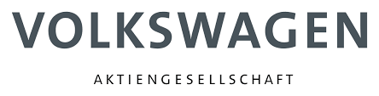



6
Years of
data space engineering
425
People contributing
22
Countries represented
130+
Notes:
To establish the IDS standard of data sharing, companies, research institutions, associations and initiatives joined forces in 2016 to form the International Data Spaces Association
Today, the IDSA has more than 130 members around the world.

Slide 9

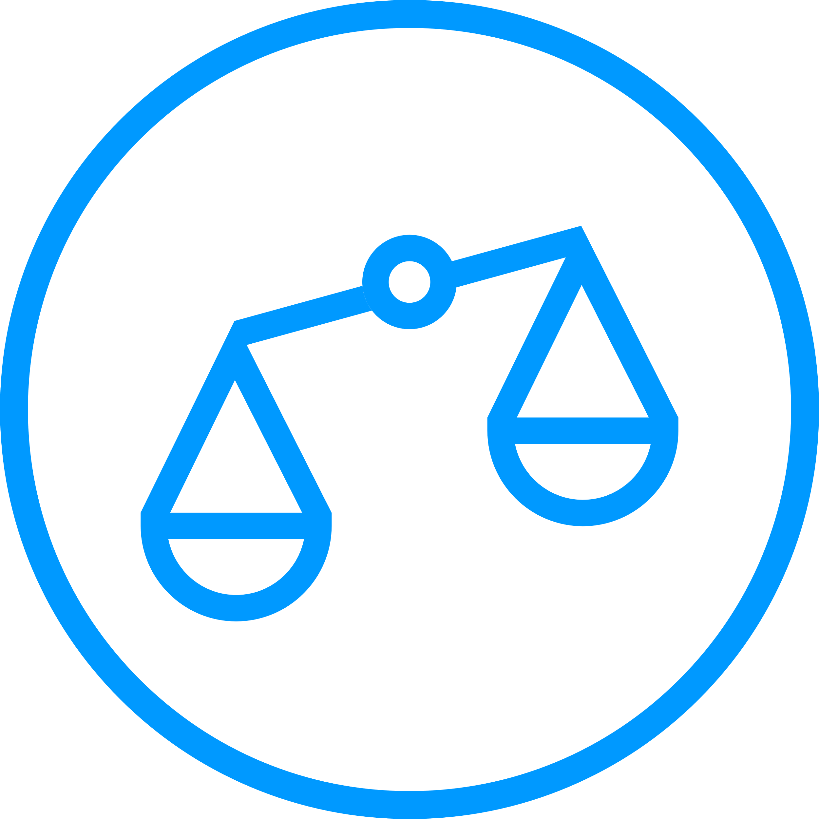
International Data Spaces Association
Driving data freedom for the whole world
The International Data Spaces Association (IDSA) is a coalition of more than 130 member companies that share a vision of a world where all companies realize the full value of their data in secure, trusted, equal partnerships.
1
Develop a reference architecture for international data spaces (IDS), including a governance model and adoption strategy
2
Continue to evolve IDS-based use cases
3
Establish IDS as the international standard for data exchange in the economy of the future
The IDSA is a not-for-profit organization. All members contribute equally to the association’s results. These are publicly available and can be used by any company or organization.
4
Support the certification of IDS-based software solutions and business models
5
Shape the future of IDS with open source

Slide 10

International Data Spaces Association
Thorough basis for data spaces
2
Security and data sovereignty
Components of IDS rely on current security measures. This is realized by certification and usage control enforcement.
Trust
1
Trust is supported by an identity management providing information about the participant based on certification.
3
Ecosystem of data
The IDS architecture pursues the idea of decentralized data storage: data physically remains with the data owner until it is transferred to a trusted party.
Data Markets
6
4
Standardized interoperability
IDS enables the creation of data driven services and fosters new business models for those services.
The IDS Connector is the central component of the architecture. Each connector can communicate with every other component in IDS
Value adding apps
5
IDS enables app injection to connectors to add services on top of the pure data exchange.

Slide 11




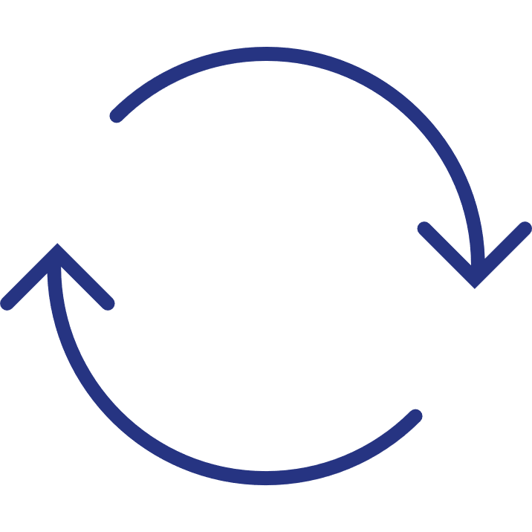


IDSA Governance
IDS Offering (Creation of the IDS Standard)
IDS Adoption (Proliferation of IDS Standard)
IDSA Rule Book
IDSA Support Organization
Adoption Accelerator
Projects on
Adoption
Radar
IDS
Communities
Minimum viable data space
IDSA Portfolio of Building Blocks
Projects
5 components
Graduate
Reference testbed
Incubating
Sandbox
Minimum viable data space
IDSA Certification Scheme
Backlog
Roadmap
Functional and technical requirements of IDS
Notes:
We deliver the thorough foundation for data spaces with the RAM and the Rule book
We have the proof for interoperability with the testbed
The certification scheme ensures conformity with third parties
We are working on concrete projects to be used in commercial set-ups with the open-source endeavour (eclipse)
IDSA is the clear producer of trust for data spaces

Slide 12



The Magic Triangle
IDSA as reliable base for data spaces
Guarantee interoperability in data spaces and between data spaces
Holistic governance to run data spaces
Reliable foundation for commercial offerings (including clear lifecycle, change management, versioning)
Ensure trust in data spaces
IDS Reference Architecture
Blueprint for data spaces with detailed specifications
1
IDSA Rulebook
How to implement IDS in the real world
TRUST
Certification Scheme
1
1
3rd party conformity allows for an informed decision about the trustworthiness of partners and components in a data space
Portfolio of open source building blocks
Bring IDS in commercial set-ups
Notes:
These 3 elements: The RAM, the certification scheme, and the open-source building blocks, comprise the Magic Triangle. The RAM is the blueprint for data spaces, providing detailed specifications of all the required roles and components. The certification scheme delivers conformity to the RAM so that partners can make informed decisions about whom they share their data with. The open-source building blocks are needed to implement the IDS standardization. They enable even non-IDSA members to participate in our project – vital if IDS is to enter commercial setups.
In sum, the Magic Triangle provides everything needed to share data in confidence. I

Slide 13
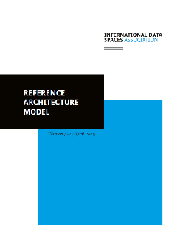
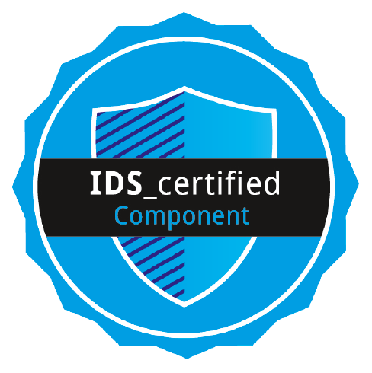
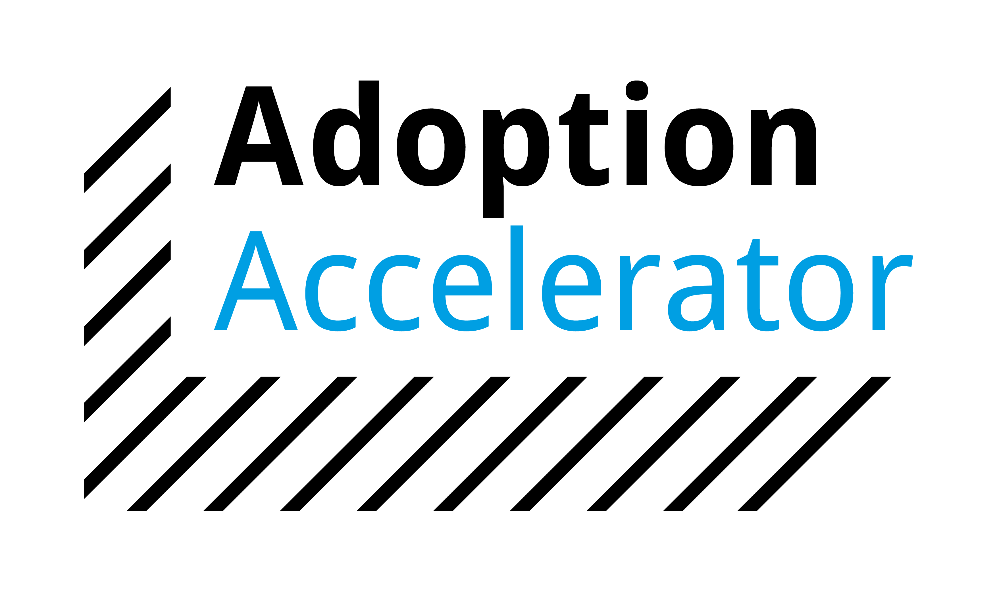

International Data Spaces Association
Core pillars of IDS offering
Open Standard
3rd party conformity
Open Processes
Open Source
De-facto standard
Reference
Architecture 3.0
Separation of duties, specification of archetypal roles
Technology agnostic
Trust, security, interoperability, governance
Certification scheme
Trustworthy components and runtime environment (criteria lists)
Attestation of interoperability
to essential services (automated testing)
IDSA organizes 3rd party trust via Support organization
Rule Book 1.1
Technical, functional, operational, maintenance
and legal agreements
Conventions for IDSA trust scheme
Soft infrastructure
IDS-G: Github repo
30+ repositories
Connector, information model, usage control schemes, metadata broker, DAPS, …
Maintain ”minimal viable data space”
via technical steering committee
Portfolio of compliant projects
Adoption strategy
Use case radar
Increasing maturity
of data spaces endeavors
Network of implementation partners
Launch coalition, Adoption accelerator
Knowledge base
International hubs
Notes:
Th

Slide 14
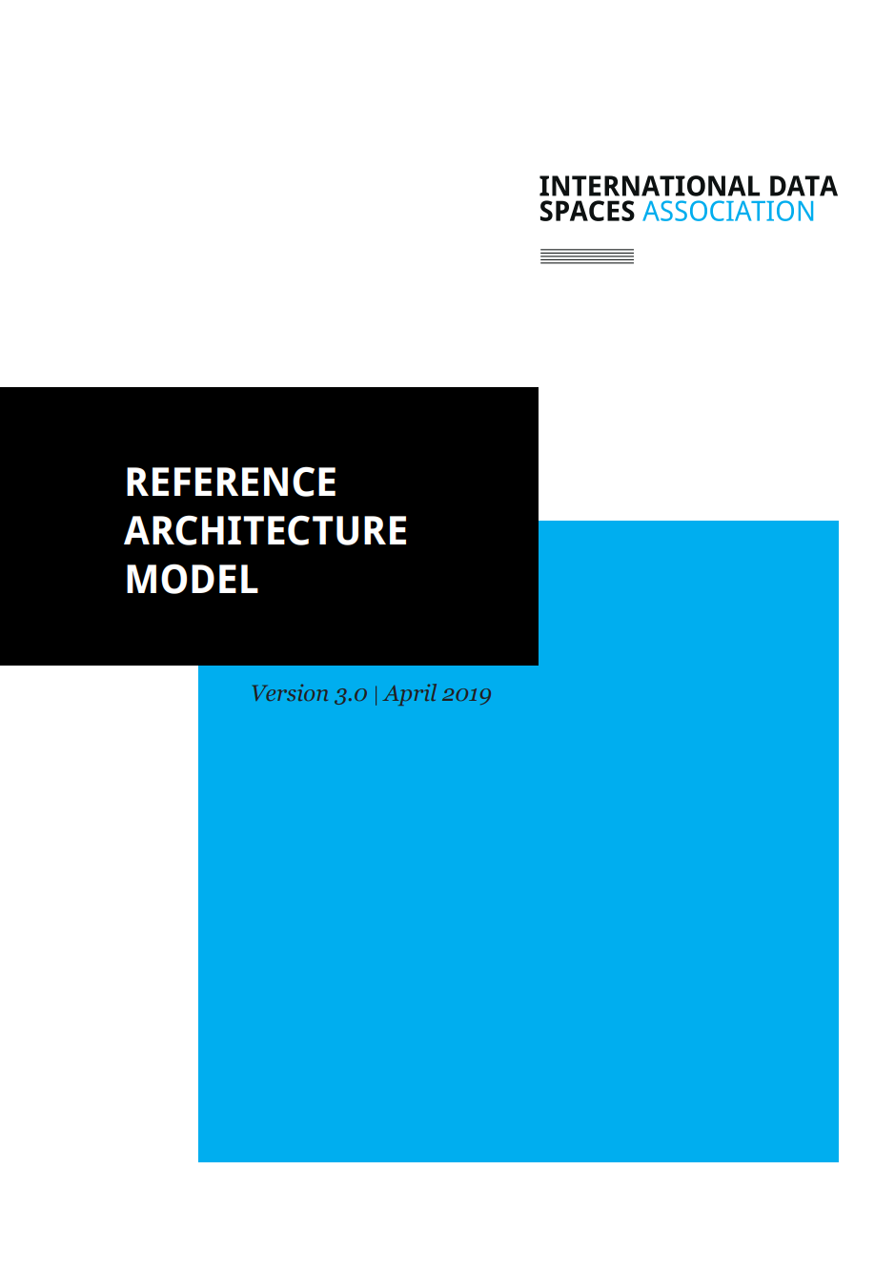
IDS Reference Architecture Model
The beating heart of the IDS
a blueprint for trustworthy data-driven ecosystems
comprises the standards for secure and sovereign data exchange, certification and governance for across Europe and around the world
offers organizations the power to develop and utilize vendor-independent data ecosystems and marketplaces, open to all, at low cost and with low entry barriers

Slide 15




What is the IDS-RAM?
Let‘s get real
Role
model
Data sovereignty
Information model
Usage policy enforcement
practical blueprint for ethical and design principles
ensures trustworthiness in data exchange and true data sovereignty
enables self-determination and control over data usage
open, agnostic with regard to technologies and domains
enables the comprehensive description of data assets and interoperability
framework for technically enforced agreements for data sharing
Notes:
A data space a concept that defines the interaction of various technological components to promote cross-company data sharing. This concept is captured in the International Data Spaces Reference Architecture Model (IDS-RAM).
The IDS-RAM was developed by the Fraunhofer Gesellschaft in 2014 as part of a research project and tested in numerous use cases. The open architecture describes how a data space must be structured so that companies can exchange and combine their data in a trusted manner. The idea of decentralized data storage is essential. The data remains physically with the respective data owner. He defines the terms of use. Data is transferred with the help of the connector, the most important component of a data space. The connector connects the participants with each other and thus represents the end point for data sharing. The IDS-RAM ensures data sovereignty.

Slide 16


IDS Certification
Building trust in data spaces
Collaboration between unknown partners is the core of IDS. Successful cooperation needs total trust.
IDS certification defines common security standards for the technical components and the operational environment of data exchange.
IDS certification of technical components and the operational environment is a transparent process.
Standardization and transparency enable an informed decision about the trustworthiness of all participants and components of a data space.

Slide 17

IDS Certification
With full transparency on two levels
Core Component Certificate
How secure is the component used?
The evaluation and certification of IDS core components is based on whether they provide the required functionality, interoperability and security regarding the security profiles.
Operational Environment Certificate
With whom do I want to exchange my data?
The operational environment includes the physical environment, defined processes and organizational rules.
Notes:
The participants in the data space collaborate by sharing their valuable data. The success of this collaboration depends on trust among all parties involved, and this, in turn, is guaranteed by a transparent certification of the environment and components. This two-pronged approach provides a high level of trust and security.

Slide 18
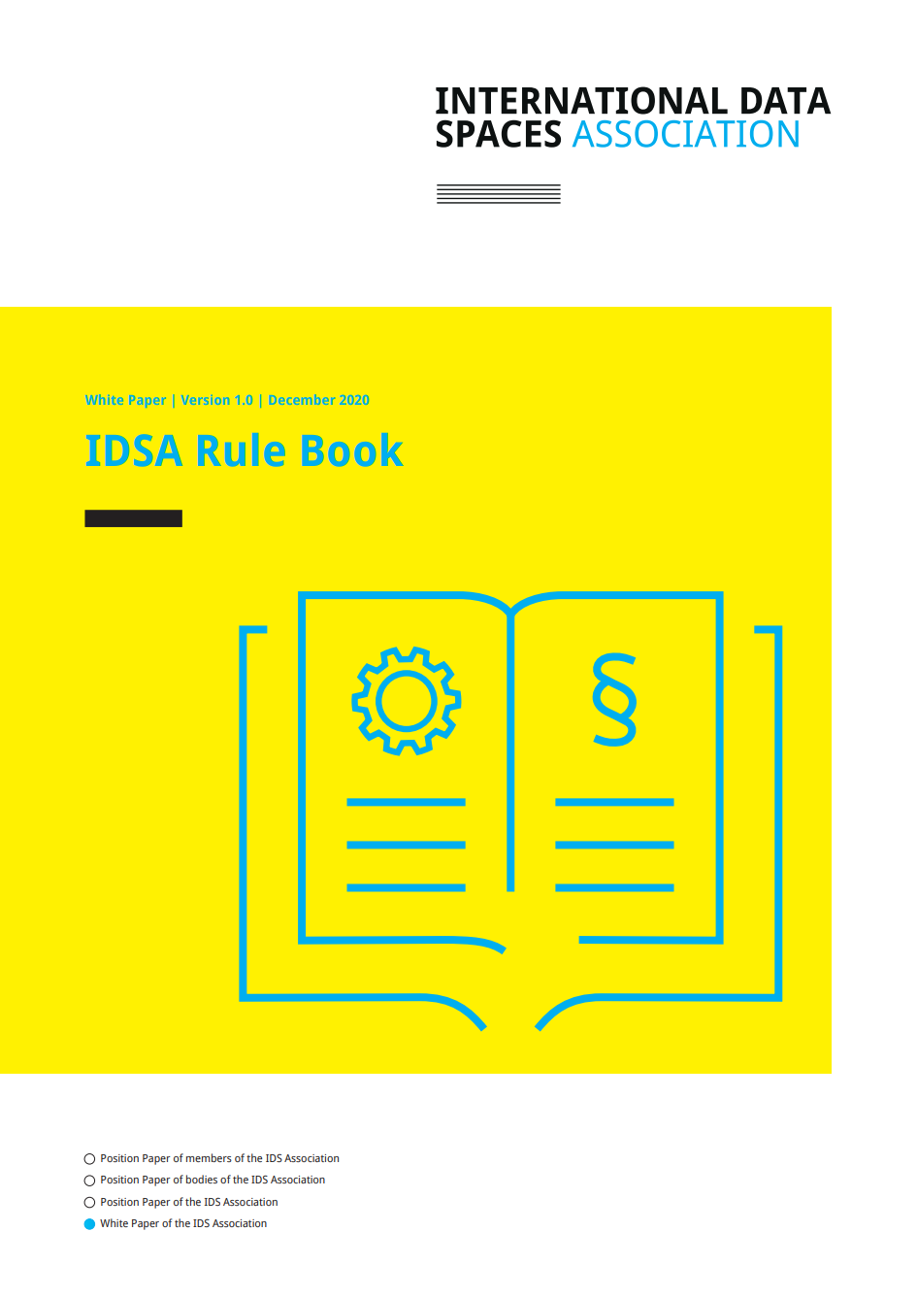
IDSA Rule Book
How to implement the IDS-RAM in the real world?
describes the technical, operational, and legal agreements to enable the IDS ecosystem to be fully working in a real-world scenario.
outlines a common governance framework that all players need to abide to, for a smoothly running future data economy.
is industry-agnostic, and applicable in all verticals as a horizontal standard.
Notes:
The Connector shall provide a sufficiently high degree of trust and security regarding the integrity, confidentiality and availability of information exchanged in the IDS. Nevertheless, the IDS Certification has a flexible setup and provides different levels of certification according to the intended use cases Connector component.
To ensure on the one hand a low entry barrier specifically suitable for SME’s and on the other hand a scalable certification to meet high information security requirements, three different security levels, with an increasing extent of the security requirements that need to be fulfilled

Slide 19
IDSA Rule Book
Functional agreements
1
2
Technical agreements
Guidance on functionality of common services as well as definition, processes and services of dedicated roles
Everything you need to know to implement or use a technical artefact of the IDSA world.
Liaisons agreements
6
3
Operational agreements
Liaisons agreements are about guiding principles guard-railing for these collaborations.
Everything you need to know to runy and collaborate (technically) within data sovereignty services.
Commercial assumptions
5
4
Legal agreements
Commercial agreements are not part of the rule book, but we make some commercial assumptions regarding essential services, base services enabling functionality, and higher-profit services on top of that. Commercial agreements will be discussed separately.
The legal agreements governing data exchange are a critical success factor This book provides guidance on on how organizations may define the rules and legal agreements for trustworthy collaboration.

Slide 20

IDS Open Source
Turning projects into communities and users into contributors
Collaborative creation
Everyone involved in IDS wants implementations to reach the highest quality possible — the IDS Open-Source landscape maximizes the possibilities.
Become a contributor
use this opportunity to meet other members of the community, review the code, provide feedback, report bugs, and improve the quality and functionality of end products.

Slide 21


IDS Open Source
IDS_G repositories
IDS Think Tank
Early discussions
Neutral Collaboration
Less rules, but creativity
IDS_G-pre
Preparation of recommendations and specifications
Approval by IDSA Working Groups and TSC
IDS_G
Public and stable state of specifications with quarterly releases
Single point of truth
https://github.com/International-Data-Spaces-Association/IDS-ThinkTank
https://github.com/International-Data-Spaces-Association/IDS-G-pre
https://github.com/International-Data-Spaces-Association/IDS-G

Slide 22
IDS Adoption
5 Steps Towards a Data Space
1
2
3
4
Gather knowledge
and find your role
Create your data sharing use case
Build or buy the necessary components
Prepare for bringing your use case to life
Adoption
Get a better understanding of IDS core ideas and identify whether your company needs an IDS solution or aspires to support others in creating data spaces.
Transform your business need into an IDS-based data sharing use case and connect with others to co-create or get support in your journey.
Identify the specific components needed for your use case and get support to design and develop them.
Go through IDS certification and finalize the preparation of your components for getting into a data space.
Go Live and benefit from secure and sovereign data sharing.
  GitHub:
  https://github.com/International-Data-Spaces-Association

Slide 23



IDSA Adoption
Accelerating the adoption curve: the USP
Data Space Radar
Knowledge Base
Community
Trailblazers
Alliances
Mapping and monitoring progress of IDS use cases/data spaces
Creation of easy to understand & use information material
Dissemination of implementation guide and technical specifications
Broad community stimulates data spaces growth and accelerate market adoption
1-on-1 support for most promising endeavours and leading platform and service providers
Bringing the right implementation partners in contact with new projects
to accelerate adoption activities with frontrunners and bring IDS to new vertical
Contributing with adoption tools, processes and community to growth and harmonization of data spaces
Notes:
A data space a concept that defines the interaction of various technological components to promote cross-company data sharing. This concept is captured in the International Data Spaces Reference Architecture Model (IDS-RAM).
The IDS-RAM was developed by the Fraunhofer Gesellschaft in 2014 as part of a research project and tested in numerous use cases. The open architecture describes how a data space must be structured so that companies can exchange and combine their data in a trusted manner. The idea of decentralized data storage is essential. The data remains physically with the respective data owner. He defines the terms of use. Data is transferred with the help of the connector, the most important component of a data space. The connector connects the participants with each other and thus represents the end point for data sharing. The IDS-RAM ensures data sovereignty.

Slide 24
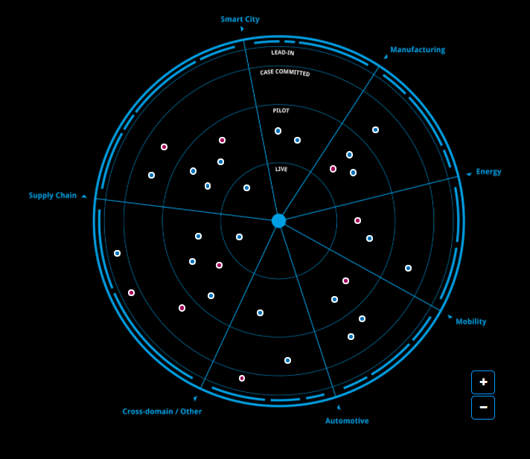
Data Space Radar
Mapping and monitoring IDS use cases
Domains
Inspiring Success Stories from different domains
supported by our experts
a
Maturity Levels
Covering use cases from business case generation
to real-life data spaces
Progress Monitoring
Forward looking radar. We make room for new items
and highlight moving data spaces
https://internationaldataspaces.org/adopt/data-space-radar/

Slide 25
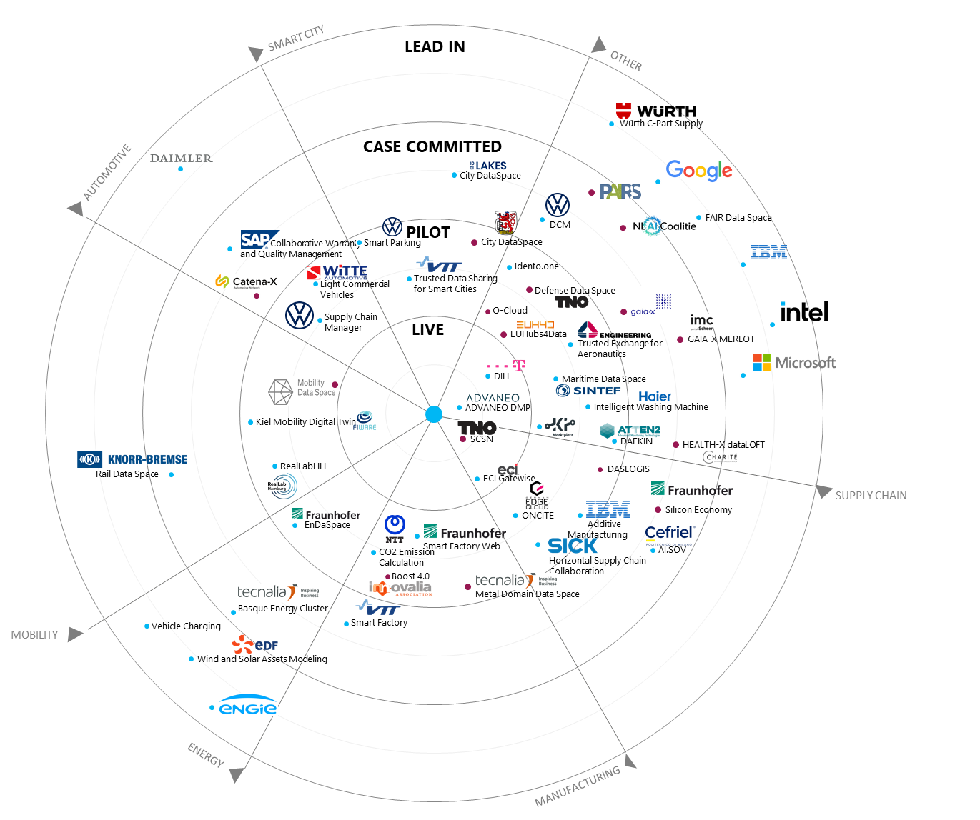
Data Space Radar
Current overview

Slide 26

The European Strategy for Data
… is based on data spaces!
9
European Data Spaces
Availabilty of large pools of data
Infrastructure to use and exchange data
Appropriate governance mechanisms
Data spaces in key sectors
Manufacturing
Green
Mobility
Health
Finance
Energy
Agriculture
Public Administration
Skills
No silos!
Enlarge the data pool!
Cross-sectoral benefits!
Notes:
The concept of Data Spaces was taken up by the European Commission in 2020 in its Strategy for Data.
The EU wants to create a single market for data in which companies can exchange their data across industries. In doing so, they should be able to rely on European regulations and values being observed.
The EC defined nine key sectors for the implementation of the EU data strategy. Interoperable Data Spaces are to be created here.

Slide 27
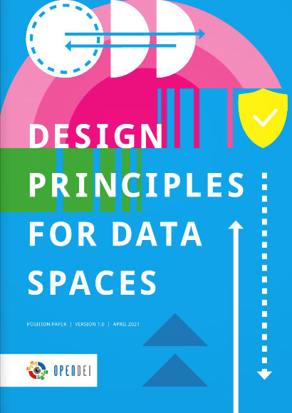
Fundamental Design Principles
… for data spaces to be built on
This co-created in the EU funded CSA OpenDEI and written down
in the Paper “Design Principles
for Data Spaces”
OpenDEI Background
Digitizing European
Industry Program
40 organizations involved
27 big EU projects, hundreds
of companies
Fundamentals of data spaces, building blocks, future governance, transition
1
Data Sovereignty
2
A level playing field for data sharing and exchange
3
A distributed soft infrastructure
4
Public-private governance
www.design-principles-for-data-spaces.org

Slide 28
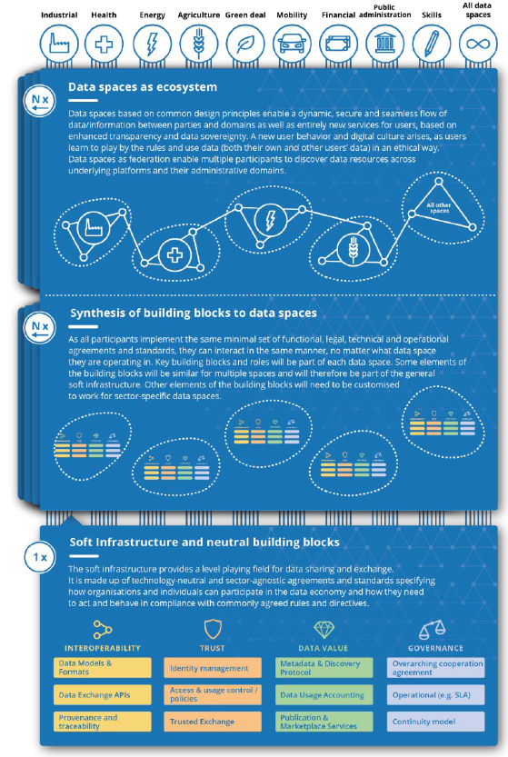
Soft Infrastructure for Europe
… will enable thousands of data spaces
IDSA Rulebook and the Design Principles for Data Spaces with
the inherent Building Blocks for data spaces for the foundation for a softinfrastructure for data spaces in Europe.
Facilitate data sovereignty and platform interoperability
Ensure mass adoption and scalability
Sector-agnostic
Coordinated development combining technological,
functional, operational and legal process
Agreements and standards aligned with building blocks
Notes:
The open reference architecture (IDS-RAM), the IDS Rulebook and the design principles for Data Spaces form the basis for a soft infrastructure for Data Spaces in Europe.
The infrastructure for European data spaces will not be a monolithic, centralised IT infrastructure.
Instead, it will be made of the totality of interoperable implementations of data spaces complying with a set of agreements in terms of functional, technical, operational and legal aspects.
Such a ‘soft infrastructure’ will be invisible to data space participants.
It will entail functional and non-functional requirements regarding interoperability, portability, findability, security, privacy, and trustworthiness.
Such a European data space ecosystem will not only give rise to new services that ensure transparency and data sovereignty. It will also create a level playing field for data sharing and exchange. The result: less dependence on large, quasi-monopolistic players and more opportunities for businesses and individuals. To the extent that users learn to play by the rules and use data in an ethical way, a new digital culture will emerge.

Slide 29
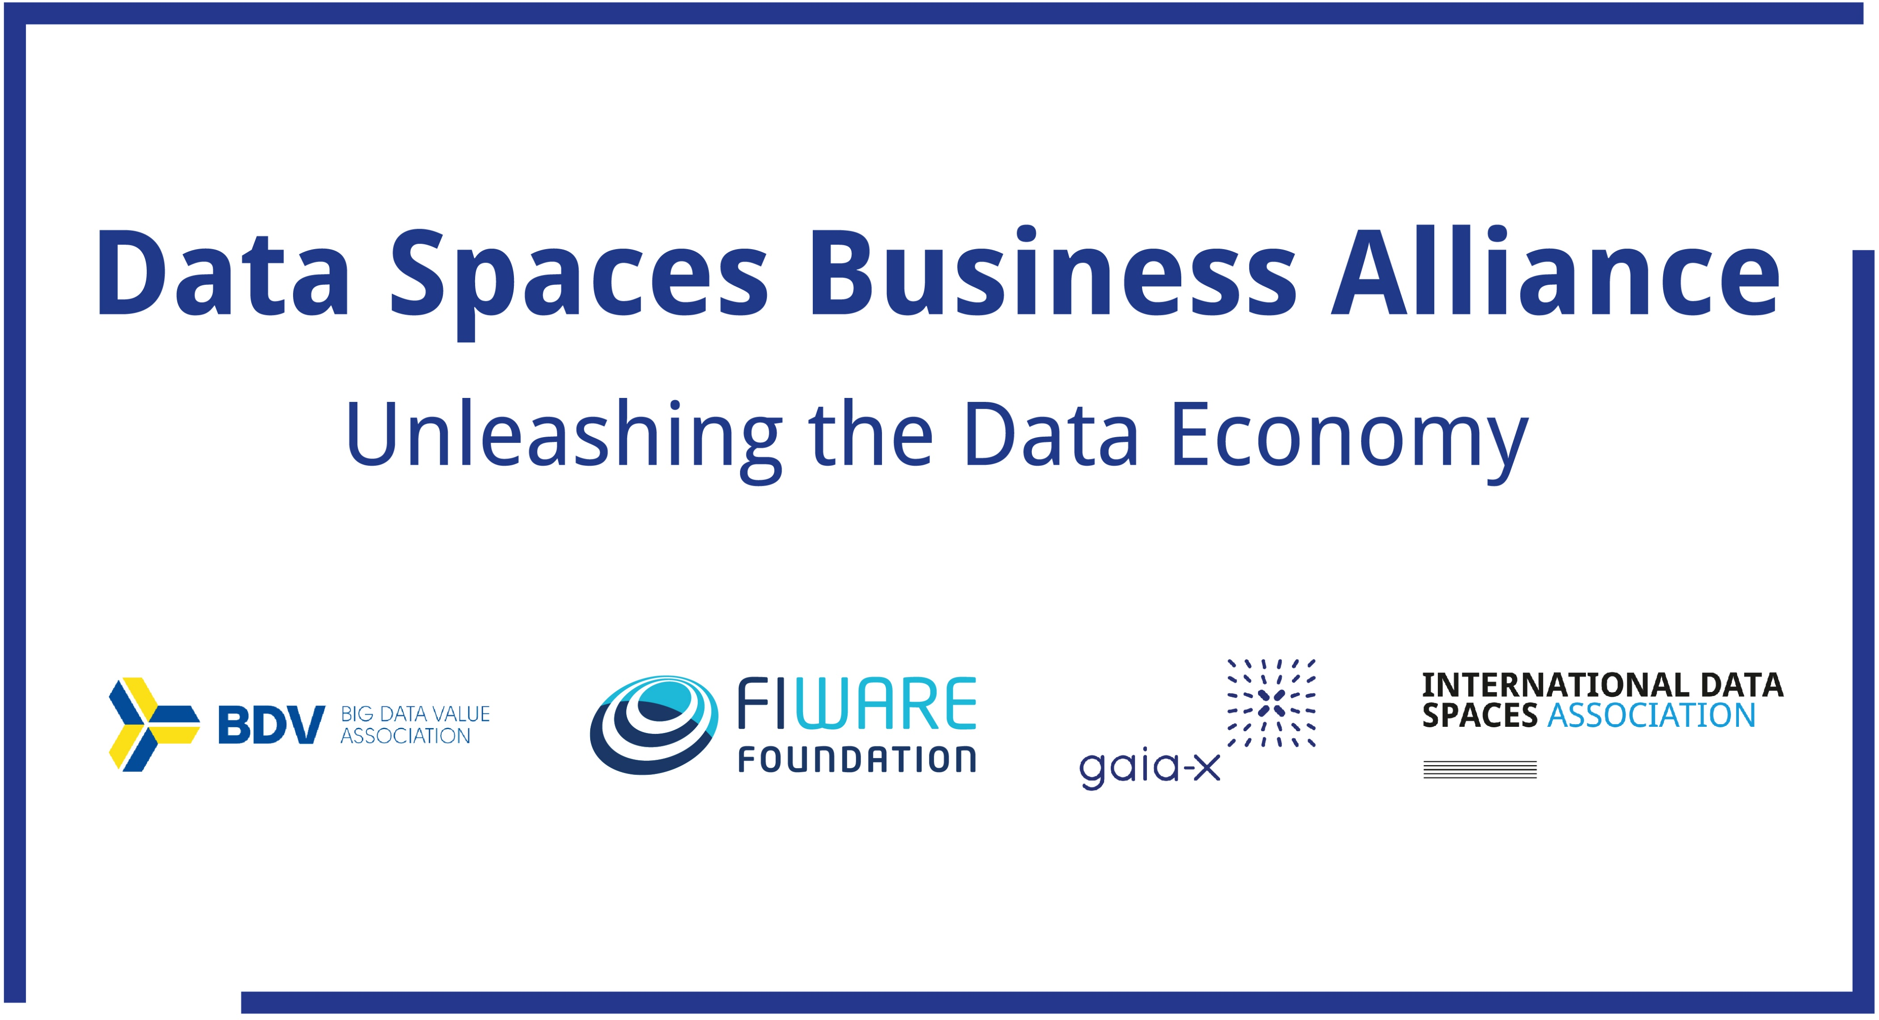
How to Realize: by Teaming up
Data spaces are a joint endeavor
Notes:
This is supposed to be a general slide about teaming up with other initiatives

Slide 30
The Data Spaces Business Alliance
is working together in three major areas
3
3
Technology and Architecture
The Alliance defines a common reference model, based on existing architectures and models. It drives interoperability by harmonizing technology components and other elements.
Support
The Alliance assists organizations and data spaces by pooling their tools, resources and expertise. The support includes handbooks, roadmaps, access to Digital Innovation Hubs (DIHs) and includes a go-to-market toolkit.
Identification and Characterisation
The Alliance establishes a “Data Spaces Radar” to scout potential data spaces. It provides an overview on data spaces on a European level. The Alliance also promotes frontrunners and identifies best practices used by them, for the benefit of all.

Slide 31
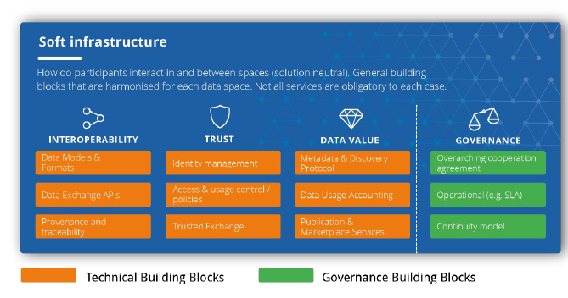
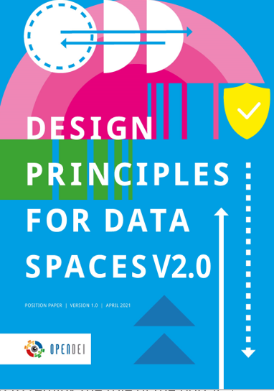




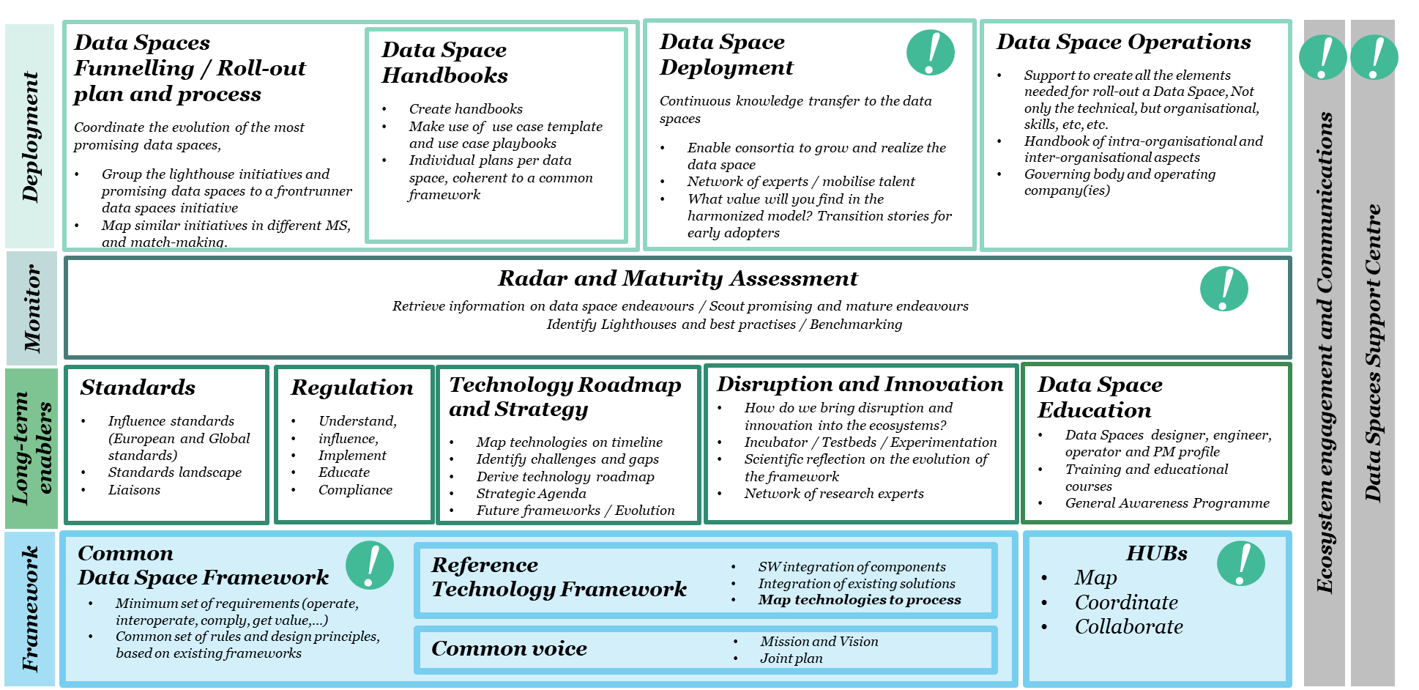




Actions to Take
Design Principles for Data Spaces
Common Data Spaces Framework as common set of rules and design principles, based on existing frameworks
Maturity level methodology to scout promising endeavors
Projects transition guide to evolve data spaces
Data Spaces Radar to give transparency
Open-Source components, running code
Templates, tools and deployment support
Data Spaces Operations – concepts, continuity models, start-ups
DSBA Work Plan

Slide 32





International Data Spaces Association
... is colaberative, dynamic, inclusive
Research insights
User driven project
Networking events
New IDS business model
Certification measures
Architecture development
Defining & implementing standards
Exchange btw research & industry

Slide 33



Get involved!
What‘s in it for you?
Use cases
Piloting, applying and testing Industrial Data Space
Implementing requirements
in the development of the architecture
Development of Smart Services
Workings groups
Participation in working groups
Regular exchange with all member companies
Dealing jointly with problems concerning data exchange
Exchange of information
Transferring the content
of the research project
Common events
Networking events
Organisation of marketing
activities/fairs
Business development
Development of business models
in the IDS
Innovation camp
Development of common user models
Architecture
Support to help design
the reference architecture
Hands on workshops
Agile software development
Standardization/certification
Defining and implementing standards
Designing the Industrial Data Space certification measures

